Slide 1
Predictive Manufacturing Solution Introduction

Slide 2

Outline
1.
Realtime Monitoring Solution
2.
Historical Big Data Analyze Solution
3.
Predictive Analytics
4.
Overall Architecture
5.
Q&A

Slide 3
Background
IPG Factory systems generate HUGE volumes of test data with a wealth of Information that can be mined for cost savings. (150GB records per day, about 2 Billion records)
A previous quality problem cost $7M which can be predicted earlier.
Problem
Speed
Scalability
Spending
7 days to get the reports
Ad-hoc & after-the-fact
Beyond Oracle’s capability
Only handle partial data
DB too large to do meaningful analysis
Difficult to scale out
License is expensive
Notes:
Traditional Data Flow: Etester→Text File→Oracle is slow and can only handle partial data
Use of data is ad-hoc and after-the-fact (7 days after)
DB too large to do meaningful analysis

Slide 4
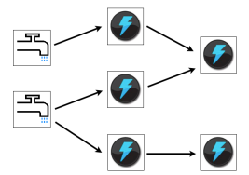
Solution Architecture
A real-time, scalable system built on top of open-source technology for comprehensive data monitoring and analytics
Apache Storm
Redis
realtime
dashboard
Kafka
Message System
historical dashboard
Vertica
Broker
Broker
…
Broker
predictive analytics
Data Generation and Transmission
Continuous Computation
Output
Kafka: Distributed Messaging System
Storm: Distributed Computation System; “the Real-time Hadoop”
Redis: In memory Database
Vertica: Column Store Database

Slide 5
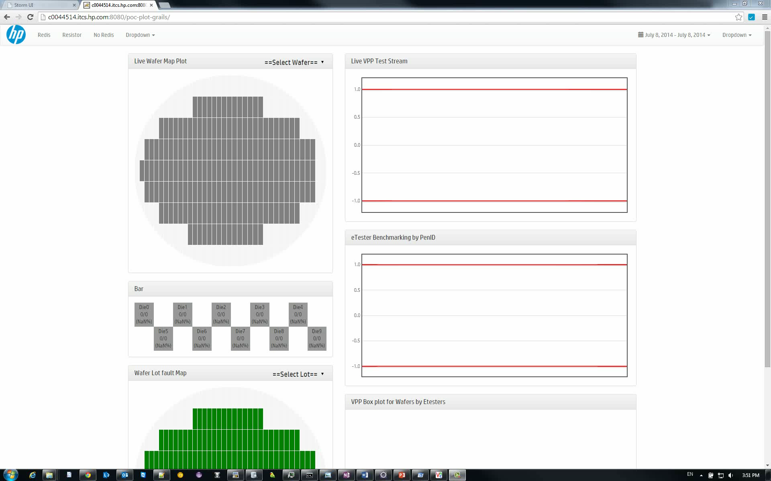

Slide 6
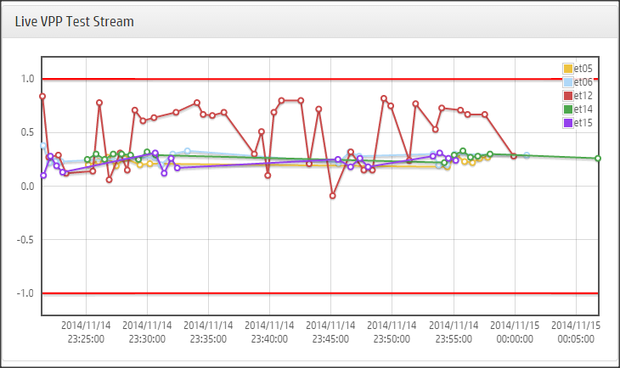
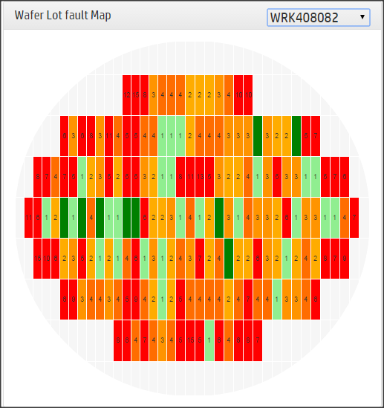
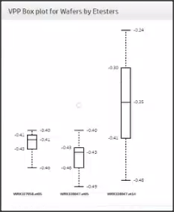
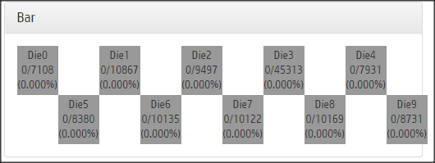
Sample Dashboard Charts

Slide 7
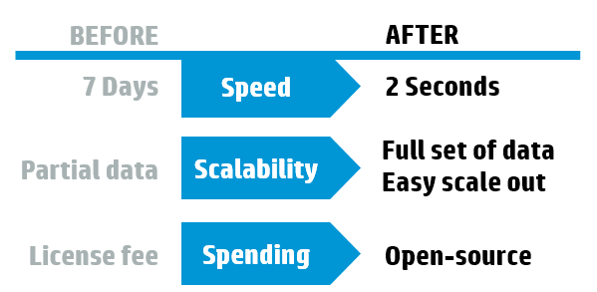
Solution Performance Benefits
Performance
Benefits
monitor important production metrics in realtime
stop producing an item when find a problem to avoid further materials waste
predict problems using R (such as anomaly detection) to reduce cost

Slide 8
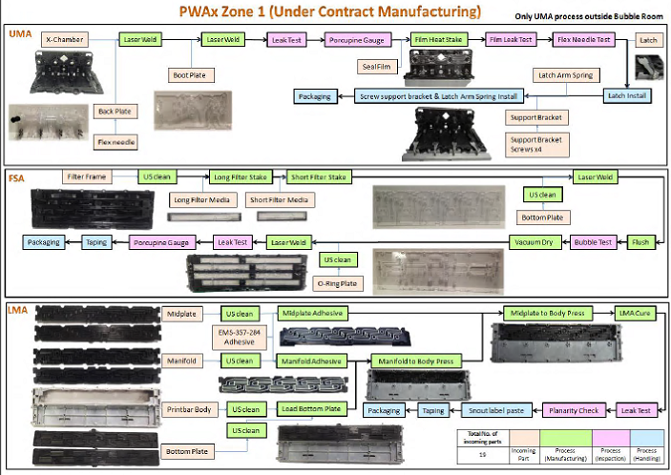
More Realtime Monitoring (developing)
Pen
Die
Resistor
…
Zone
Process
Equipment
…
Typical Scenarios (Questions to answer)
What is a PEN’s status right now? How many tests has done on it and the results?
For a process or equipment, what is its workload and failure rate?
… …

Slide 9
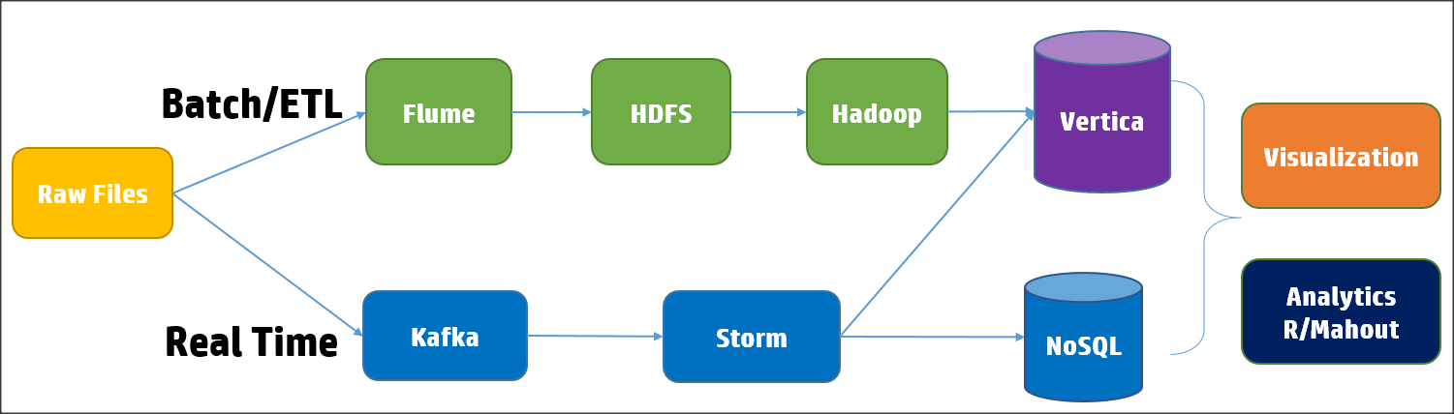
Historical Big Data Analyze
Background
Most companies have data warehouse or data marts or file Archives etc., which are information repositories can be well leveraged.
For streaming data, there is a requirement to view them together after some time.

Slide 10
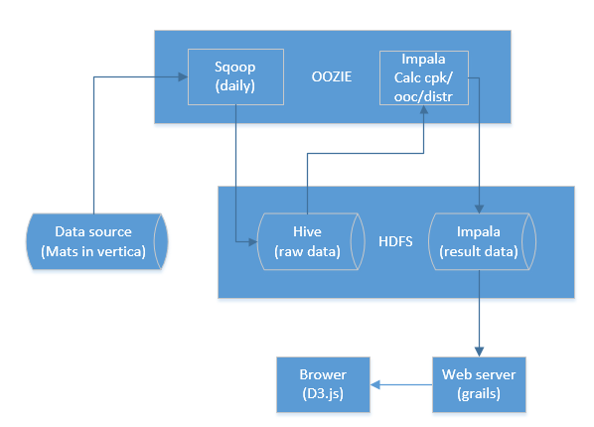
User Case
Auto PPK/CPK
PPK: Performance Index of Process
CPK: Complex Process Capability index
PPK/CPK are important manufacturing metrics
Benefits
Process 1 year data which is beyond current QlikView limitation.
Automatically calculate weekly and monthly
Notes:
CPK---过程能力指数（短期的）
PPK---过程性能指数（长期的
用来计算工序性能或叫过程性能的指数。

Slide 11
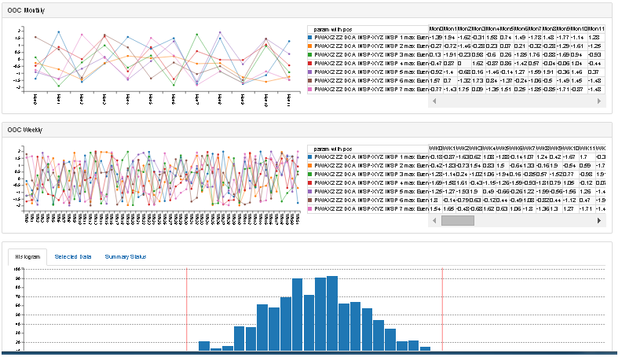
Visualization

Slide 12
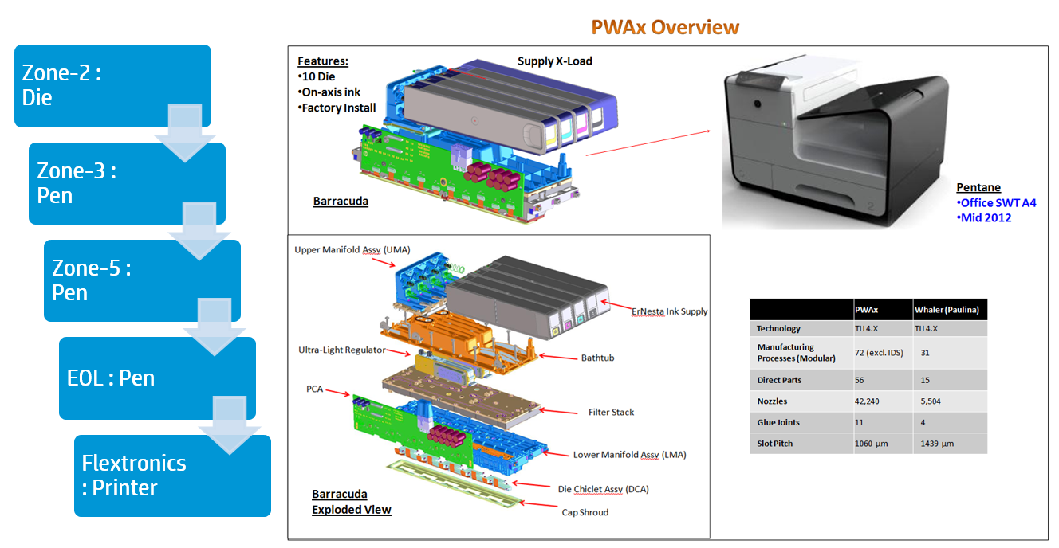
Advanced Analytics
Time is money when it comes to detecting potential quality issues.
Even a small delay in detecting a quality issue can result in large costs from reworked or scrapped product, containment or recall of defective product, increased warranty expenses, loss of customer satisfaction, and potentially even legal liability. Detecting quality issues as early as possible is extremely important.
Notes:
In any supply chain or manufacturing operation, “time is money” when it comes to detecting
quality problems. Even a small delay in detecting a quality problem can result in large costs
from reworked or scrapped product, containment or recall of defective product, increased
warranty expenses, loss of customer satisfaction, and potentially even legal liability. The scale
and complexity of current manufacturing operations, internal and contracted, made it vital that
supply chain quality problems are detected as early as possible – before suspect materials
from suppliers ever enter the manufacturing plants or make it into production

Slide 13
Data
Vertica
Hadoop Data
Streaming
Data
Computing Platform
Offline Analytics
Online Analytics
R Server
(RStudio, Shiny)
Standalone Vertica
(Distributed R)
Hadoop
(Rhadoop)
Spark
(Mlib, SparkR)
Storm/Spark
Model
Issue Analysis
Survival Analysis
Anomaly Detection
Monitoring
…
Visualization
D3.js
Qlikview
Shiny
knitr, Markdown
Recharts
…
Architecture of Advanced Analytics

Slide 14
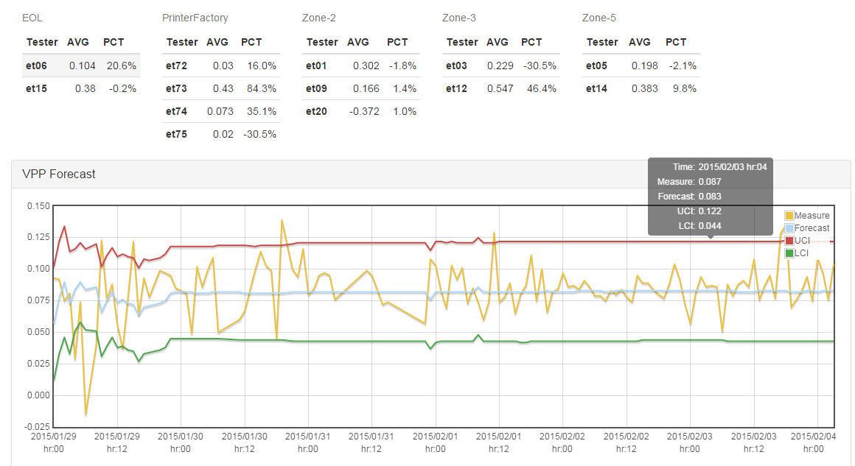
ALL_VPP Time Series
Zone-2, Zone-3, Zone-5, EOL and PrinterFactory forecasting
http://c0044514.itcs.hp.com/pdms-data-visualization/forecast/index

Slide 15
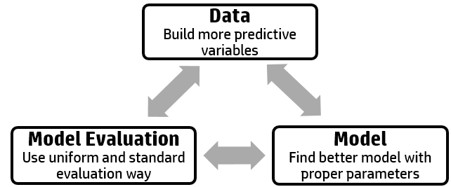
Anomaly Detection
Predict the leakage failure of next Zone. For example, use Z2 data to predict the failure probability on Z3, Z5 or EOL.
Prevent Failures
Identify root cause for PN failure
Find the failure as early as possible
Predictive Objective
Z2 + Z3 + Z5 + EOL => Flex
Z2 + Z3 + Z5 => EOL
Z2 + Z3 => Z5
Z2 => Z3
Z2 => Z5
Z2 => EOL
Z2 => Flex

Slide 16
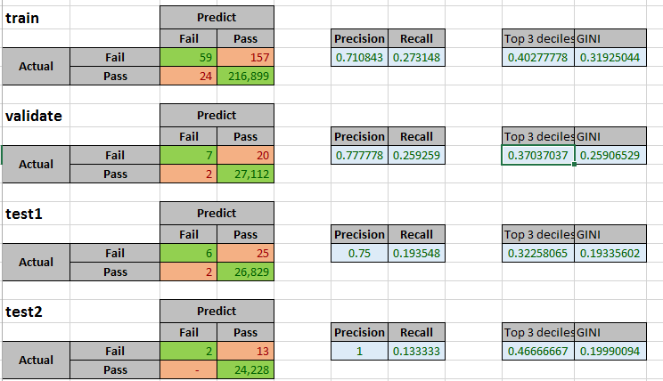
GBDT

Slide 17
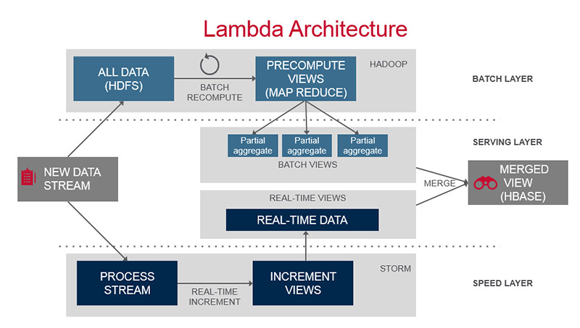
A Typical Big Data Platform Architecture

Slide 18
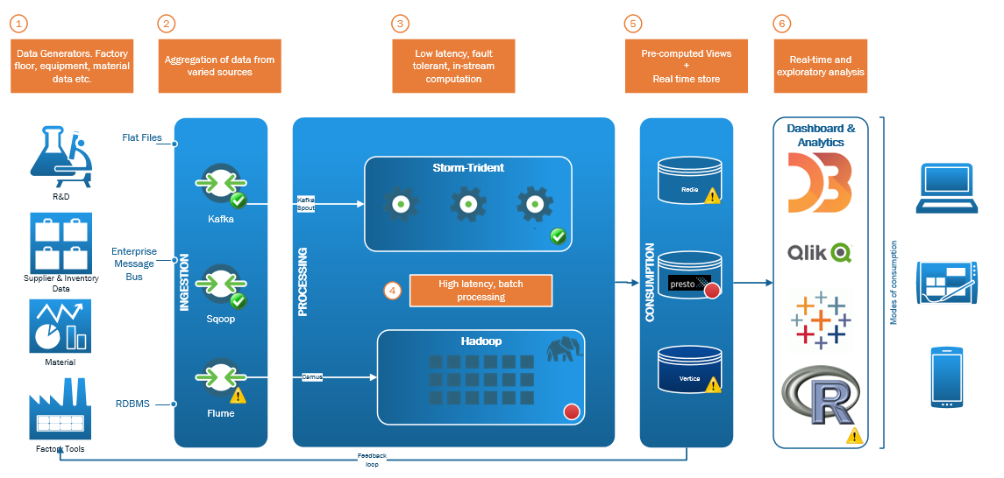
Overall System Design

Slide 19



Slide 20
Thank you

